Slide 1

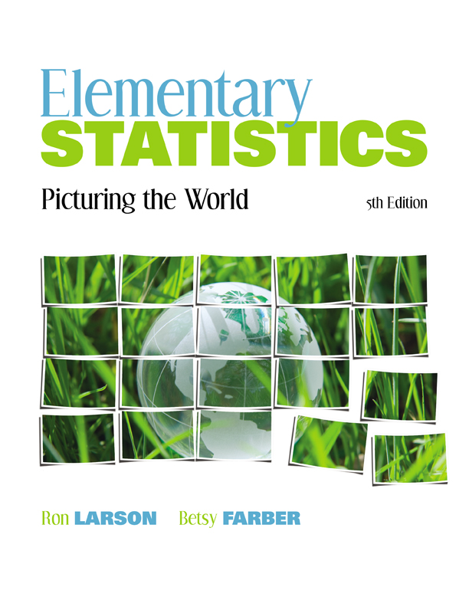

Chapter
3
Probability
© 2012 Pearson Education, Inc.
All rights reserved.
<number> of 88

Slide 2
Chapter Outline
3.2 Conditional Probability and the Multiplication
Rule
© 2012 Pearson Education, Inc. All rights reserved.
<number> of 88

Slide 3
Section 3.2
Conditional Probability and the Multiplication Rule
© 2012 Pearson Education, Inc. All rights reserved.
<number> of 88

Slide 4
Section 3.2 Objectives
Determine conditional probabilities
Distinguish between independent and dependent events
Use the Multiplication Rule to find the probability of two events occurring in sequence
Use the Multiplication Rule to find conditional probabilities
© 2012 Pearson Education, Inc. All rights reserved.
<number> of 88

Slide 5
Conditional Probability
Conditional Probability
The probability of an event occurring, given that another event has already occurred
Denoted P(B | A) (read “probability of B, given A”)
© 2012 Pearson Education, Inc. All rights reserved.
<number> of 88

Slide 6
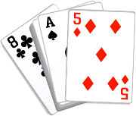
Example: Finding Conditional Probabilities
Two cards are selected in sequence from a standard deck. Find the probability that the second card is a queen, given that the first card is a king. (Assume that the king is not replaced.)
Solution:
Because the first card is a king and is not replaced, the remaining deck has 51 cards, 4 of which are queens.
© 2012 Pearson Education, Inc. All rights reserved.
<number> of 88

Slide 7
Example: Finding Conditional Probabilities
The table shows the results of a study in which researchers examined a child’s IQ and the presence of a specific gene in the child. Find the probability that a child has a high IQ, given that the child has the gene.
 | Gene Present | Gene not present | Total
High IQ | 33 | 19 | 52
Normal IQ | 39 | 11 | 50
Total | 72 | 30 | 102
© 2012 Pearson Education, Inc. All rights reserved.
<number> of 88

Slide 8
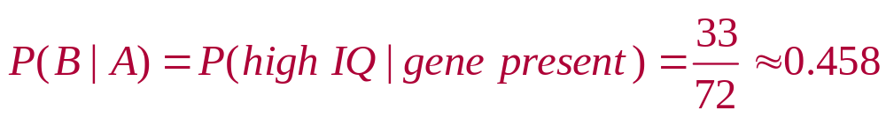
Solution: Finding Conditional Probabilities
There are 72 children who have the gene. So, the sample space consists of these 72 children.
 | Gene Present | Gene not present | Total
High IQ | 33 | 19 | 52
Normal IQ | 39 | 11 | 50
Total | 72 | 30 | 102
Of these, 33 have a high IQ.
© 2012 Pearson Education, Inc. All rights reserved.
<number> of 88

Slide 9
Independent and Dependent Events
Independent events
The occurrence of one of the events does not affect the probability of the occurrence of the other event
P(B | A) = P(B) or P(A | B) = P(A)
Events that are not independent are dependent
© 2012 Pearson Education, Inc. All rights reserved.
<number> of 88

Slide 10
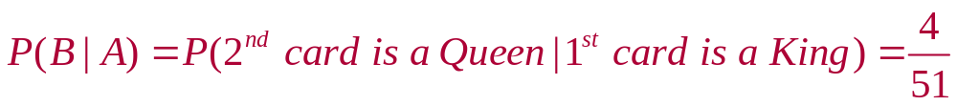
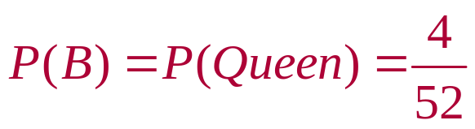
Example: Independent and Dependent Events
Decide whether the events are independent or dependent.
Selecting a king from a standard deck (A), not replacing it, and then selecting a queen from the deck (B).
Solution:
Dependent (the occurrence of A changes the probability of the occurrence of B)
© 2012 Pearson Education, Inc. All rights reserved.
<number> of 88

Slide 11


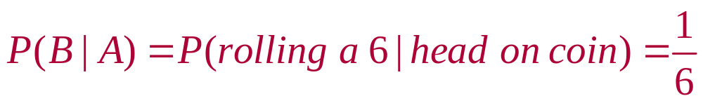
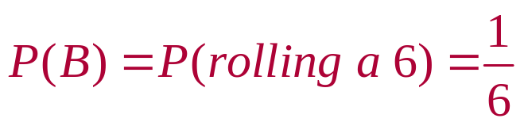
Example: Independent and Dependent Events
Decide whether the events are independent or dependent.
Tossing a coin and getting a head (A), and then rolling a six-sided die and obtaining a 6 (B).
Solution:
Independent (the occurrence of A does not change the probability of the occurrence of B)
© 2012 Pearson Education, Inc. All rights reserved.
<number> of 88

Slide 12
The Multiplication Rule
Multiplication rule for the probability of A and B
The probability that two events A and B will occur in sequence is
  P(A and B) = P(A) ∙ P(B | A)
For independent events the rule can be simplified to
  P(A and B) = P(A) ∙ P(B)
  Can be extended for any number of independent events
© 2012 Pearson Education, Inc. All rights reserved.
<number> of 88

Slide 13
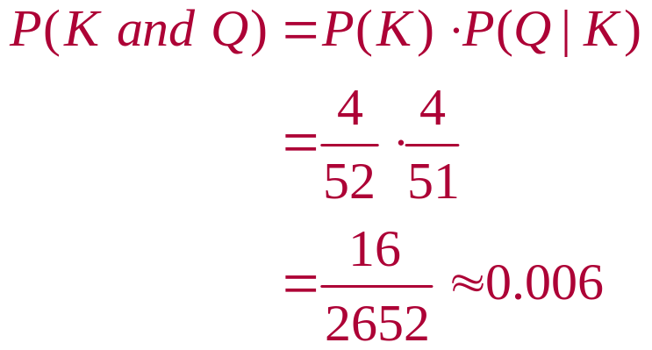
Example: Using the Multiplication Rule
Two cards are selected, without replacing the first card, from a standard deck. Find the probability of selecting a king and then selecting a queen.
Solution:
Because the first card is not replaced, the events are dependent.
© 2012 Pearson Education, Inc. All rights reserved.
<number> of 88

Slide 14
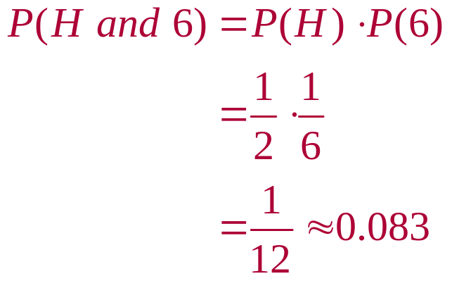
Example: Using the Multiplication Rule
A coin is tossed and a die is rolled. Find the probability of getting a head and then rolling a 6.
Solution:
The outcome of the coin does not affect the probability of rolling a 6 on the die. These two events are independent.
© 2012 Pearson Education, Inc. All rights reserved.
<number> of 88

Slide 15

Example: Using the Multiplication Rule
The probability that a particular knee surgery is successful is 0.85. Find the probability that three knee surgeries are successful.
Solution:
The probability that each knee surgery is successful is 0.85. The chance for success for one surgery is independent of the chances for the other surgeries.
P(3 surgeries are successful) = (0.85)(0.85)(0.85)
≈ 0.614
© 2012 Pearson Education, Inc. All rights reserved.
<number> of 88

Slide 16
Example: Using the Multiplication Rule
Find the probability that none of the three knee surgeries is successful.
Solution:
Because the probability of success for one surgery is 0.85. The probability of failure for one surgery is
1 – 0.85 = 0.15
P(none of the 3 surgeries is successful) = (0.15)(0.15)(0.15)
≈ 0.003
© 2012 Pearson Education, Inc. All rights reserved.
<number> of 88

Slide 17
Example: Using the Multiplication Rule
Find the probability that at least one of the three knee surgeries is successful.
Solution:
“At least one” means one or more. The complement to the event “at least one is successful” is the event “none are successful.” Using the complement rule
P(at least 1 is successful) = 1 – P(none are successful)
≈ 1 – 0.003
= 0.997
© 2012 Pearson Education, Inc. All rights reserved.
<number> of 88

Slide 18
Example: Using the Multiplication Rule to Find Probabilities
More than 15,000 U.S. medical school seniors applied to residency programs in 2009. Of those, 93% were matched with residency positions. Eighty-two percent of the seniors matched with residency positions were matched with one of their top three choices. Medical students electronically rank the residency programs in their order of preference, and program directors across the United States do the same. The term “match” refers to the process where a student’s preference list and a program director’s preference list overlap, resulting in the placement of the student for a residency position. (Source: National Resident Matching Program)
(continued)
© 2012 Pearson Education, Inc. All rights reserved.
<number> of 88

Slide 19
Example: Using the Multiplication Rule to Find Probabilities
Find the probability that a randomly selected senior was matched with a residency position and it was one of the senior’s top three choices.
Solution:
A = {matched with residency position}
B = {matched with one of top three choices}
P(A) = 0.93 and P(B | A) = 0.82
P(A and B) =
P(A)∙P(B | A) = (0.93)(0.82) ≈ 0.763
dependent events
© 2012 Pearson Education, Inc. All rights reserved.
<number> of 88

Slide 20
Example: Using the Multiplication Rule to Find Probabilities
Find the probability that a randomly selected senior who was matched with a residency position did not get matched with one of the senior’s top three choices.
Solution:
Use the complement:
P(B′ | A) = 1 – P(B | A)
= 1 – 0.82 = 0.18
© 2012 Pearson Education, Inc. All rights reserved.
<number> of 88

Slide 21
Section 3.2 Summary
Determined conditional probabilities
Distinguished between independent and dependent events
Used the Multiplication Rule to find the probability of two events occurring in sequence
Used the Multiplication Rule to find conditional probabilities
© 2012 Pearson Education, Inc. All rights reserved.
<number> of 88

